Slide 1


Slide 2

5
MONITORING JOBS AND INFLATION
Notes:
Notes and teaching tips: 4, 8, 9, 22, 26, 33, 39, 43, and 53.
To view a full-screen figure during a class, click the expand button.
To return to the previous slide, click the shrink button.
To advance to the next slide, click anywhere on the full screen figure.
Applying the principles of economics to interpret and understand the news is a major goal of the principles course. You can encourage your students in this activity by using the two features: Economics in the News and Economics in Action.
(1) Before each class, scan the news and select two or three headlines that are relevant to your session today. There is always something that works. Read the headline and ask for comments, interpretation, discussion. Pose questions arising from it that motivate today’s class. At the end of the class, return to the questions and answer them with the tools you’ve been explaining.
(2) Once or twice a semester, set an assignment, for credit, with the following instructions:
(a) Find a news article about an economic topic that you find interesting.
(b) Make a short bullet-list summary of the article.
(c) Write and illustrate with appropriate graphs an economic analysis of the key points in the article.
Use the Economics in the News features in your textbook as models.

Slide 3
After studying this chapter, you will be able to:
Explain why unemployment is a problem and how we measure the unemployment rate and other labor market indicators
Explain why unemployment occurs and why it is present even at full employment
Explain why inflation is a problem and how we measure the inflation rate

Slide 4
Employment and Unemployment
What kind of job market will you enter when you graduate?
The class of 2017 had a better time in the job market when 7 million Americans (down from 10 million in 2015) who wanted a job but couldn’t find one.
Also in 2015, 8 million people had given up looking for a full-time job and taken a part-time job.
The U.S. economy creates lots of jobs: during the recession of 2009, 139 million people had jobs—22 million more than in 1989.
In recent years, the population has grown faster than the number of jobs, so unemployment is a serious problem.
Notes:
Classroom activity
Check out Economics in Action: What Kept Ben Bernanke Awake at Night

Slide 5
Employment and Unemployment
Why Unemployment Is a Problem
Unemployment results in
Lost incomes and production
Lost human capital
The loss of income is devastating for those who bear it. Employment benefits create a safety net but don’t fully replace lost wages, and not everyone receives benefits.
Prolonged unemployment permanently damages a person’s job prospects by destroying human capital.

Slide 6
Employment and Unemployment
Current Population Survey
The U.S. Census Bureau conducts a monthly population survey to determine the status of the U.S. labor force.
The population is divided into two groups:
1. The working-age population—the number of people aged 16 years and older who are not in jail, hospital, or some other institution
2. People too young to work (under 16 years of age) or in institutional care

Slide 7
Employment and Unemployment
The working-age population is divided into two groups:
1. People in the labor force
2. People not in the labor force
The labor force is the sum of employed and unemployed workers.

Slide 8
Employment and Unemployment
To be counted as unemployed, a person must be in one of the following three categories:
1. Without work but has made specific efforts to find a job within the previous four weeks
2. Waiting to be called back to a job from which he or she has been laid off
3. Waiting to start a new job within 30 days
Notes:
Positive versus normative. Unemployment is an emotionally charged subject and is a good one for reinforcing the important point that economics is positive in contrast to normative. The economist’s job is to try to explain why unemployment exists, what determines its rate, and assess the efficient amount of unemployment.
The benefits of unemployment. It comes as a shock to most students that unemployment has benefits as well as costs and that there is an efficient amount of unemployment that is greater than zero. (Note that this statement is positive!) You might like to spend a bit of class time on this topic. If you do, here are some ideas about what to do:
A good way to introduce the idea that unemployment brings benefits is to think about the unemployment of things rather than people. Look around the campus and notice all the unemployed automobiles in the parking lots/stations. Notice the unemployed class rooms early in the morning and late at night. Notice the unemployed coffee shop seats at peak lecture times. Look around the city and notice all the unemployed automobiles in the car sales lots. Try to make a reservation at any of the hotels in the city and notice that you can almost always get a room—hence, lots of unemployed hotel rooms.
[Continued on the note for the next slide.]

Slide 9
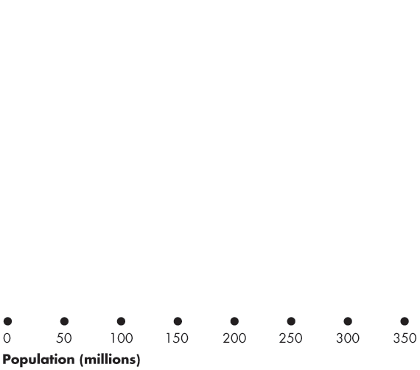
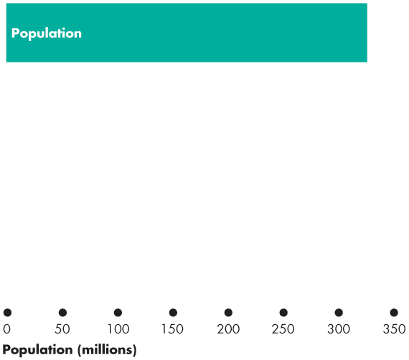
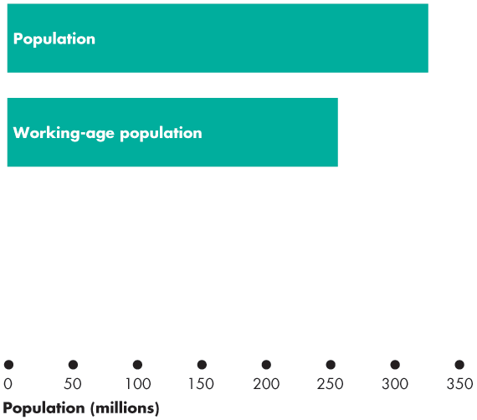
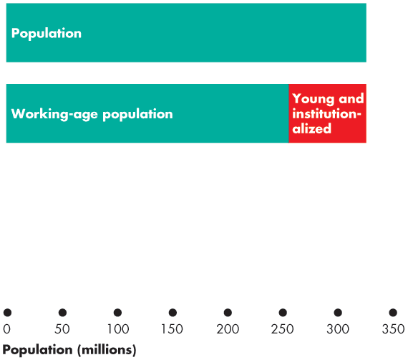
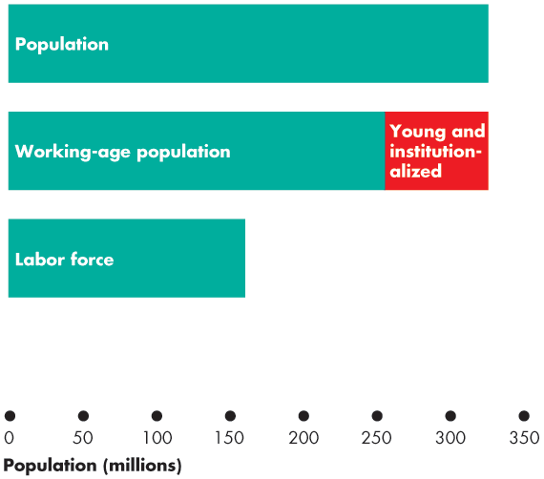
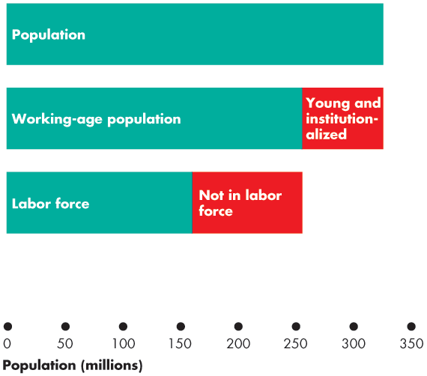
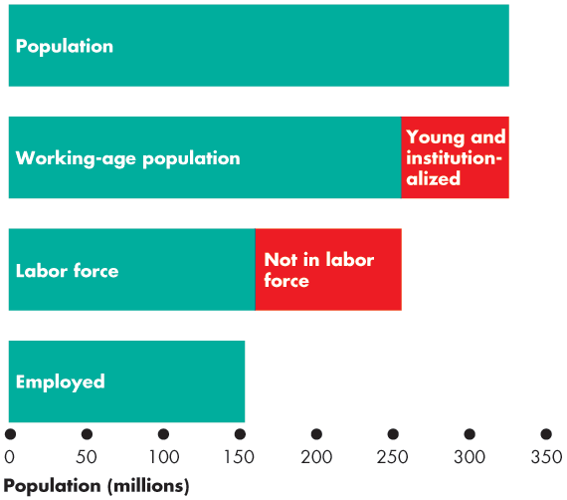
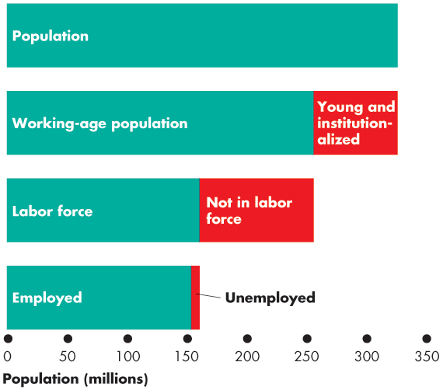

Employment and Unemployment
Figure 5.1 shows the labor force categories. In June 2017:
Population: 325 million
Working-age population: 255 million
Labor force: 160 million
Employed: 153 million
Unemployed: 7 million
Notes:
Now ask: does all this unemployment bring benefits? The students quickly see that it would be very costly to organize rental markets in which cars don’t sit idle all day, and so on.
Now ask: do the same ideas apply to unemployed people? (Be sure to be compassionate about the misery that unemployment can bring. You are not claiming that it is not costly. You’re trying to identify the benefits, if any.)
You’ll quickly get your students to see that imagining an economy without any unemployment is nearly impossible. If consumers are free to change their decisions about what they want to buy, some goods and services must fall out of favor when others come into favor. The firms making the unfavoured products fall on hard times and often their workers are fired or laid off.
Sure, these laid off workers could start work right away, cleaning shoes or selling flowers at intersections. But they are better off (in their own opinion) being frictionally unemployed and searching for new jobs. To eliminate this source of unemployment we would need to forbid consumers from changing their buying plans or insist that no one remain idle and get on with doing any job even if it doesn’t earn a wage.
Note that if this is how we ran our economy, we’d still be using coal-fired stoves and the pony express, and we’d be wearing coonskin caps. There would be no McDonald’s, Federal Express, or Nike shoes.

Slide 11
Employment and Unemployment
Three Labor Market Indicators
The unemployment rate
The employment-to-population ratio
The labor force participation rate

Slide 12
Employment and Unemployment
The Unemployment Rate
The unemployment rate is the percentage of the labor force that is unemployed.
The unemployment rate is (Number of people unemployed ÷ labor force) × 100.
In June 2017, the labor force was 160 million and 7 million were unemployed, so the unemployment rate was 4.4 percent.
The unemployment rate increases in a recession and reaches its peak value after the recession ends.

Slide 13
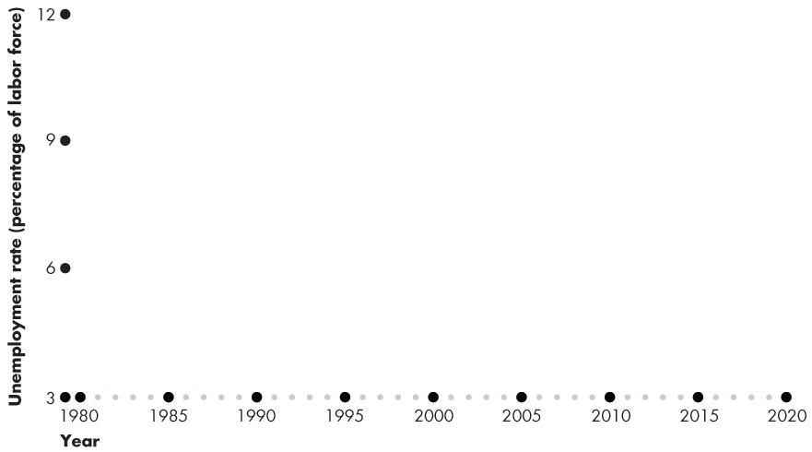
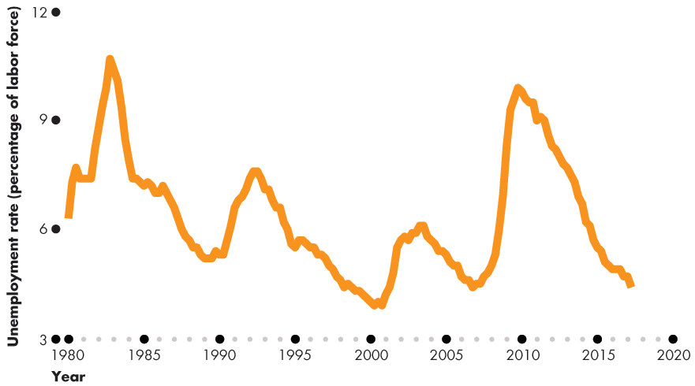
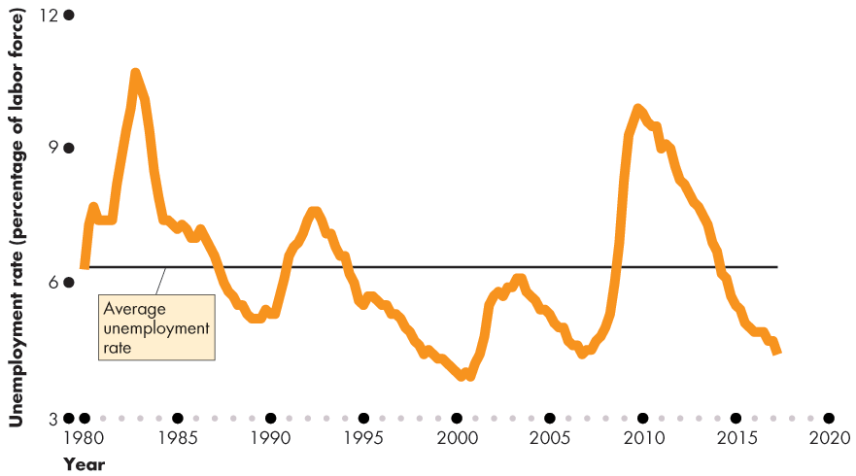
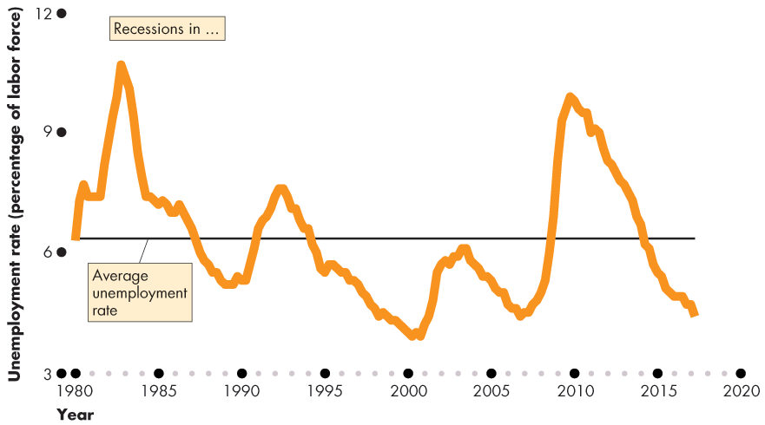
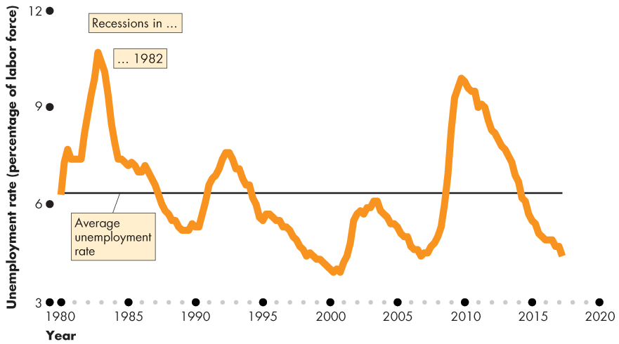
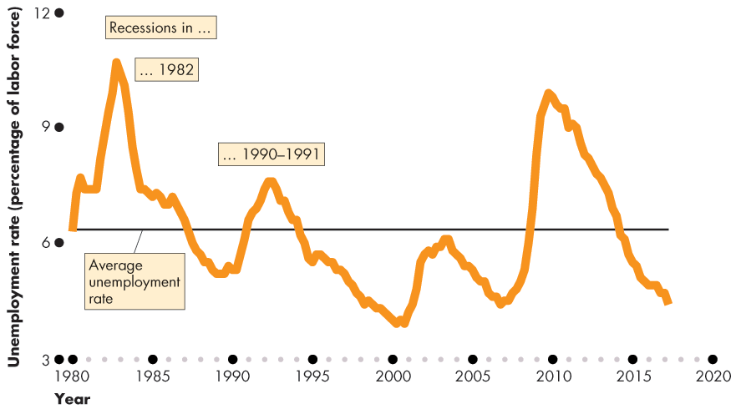
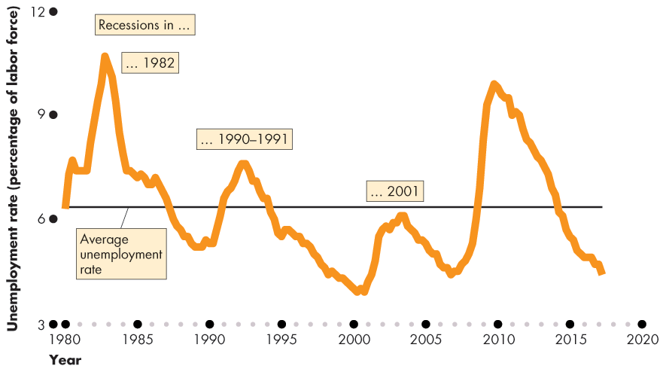
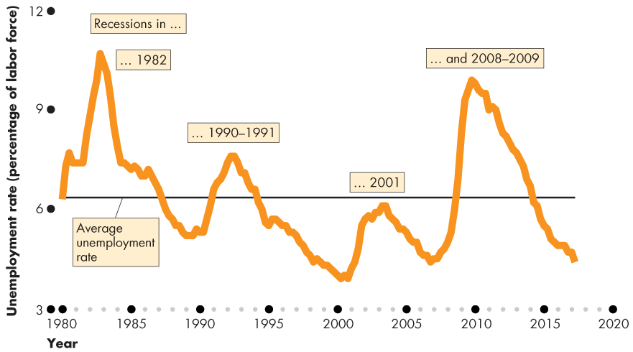
Employment and Unemployment
Figure 5.2 shows the unemployment rate: 1980–2017.
The unemployment rate increases in a recession.

Slide 15
Employment and Unemployment
The Employment-to-Population Ratio
The employment-to-population ratio is the percentage of the working-age population who have jobs.
The employment-to-population ratio is (Employment ÷ Working-age population) × 100.
In June 2017, the employment was 153 million and the working-age population was 255 million.
The employment-to-population ratio was 60 percent.

Slide 16
Employment and Unemployment
The Labor Force Participation Rate
The labor force participation rate is the percentage of the working-age population who are members of the labor force.
The labor force participation rate is (Labor force ÷ Working-age population) × 100.
In June 2017, the labor force was 160 million and the working-age population was 255 million.
The labor force participation rate was 62.7 percent.

Slide 17
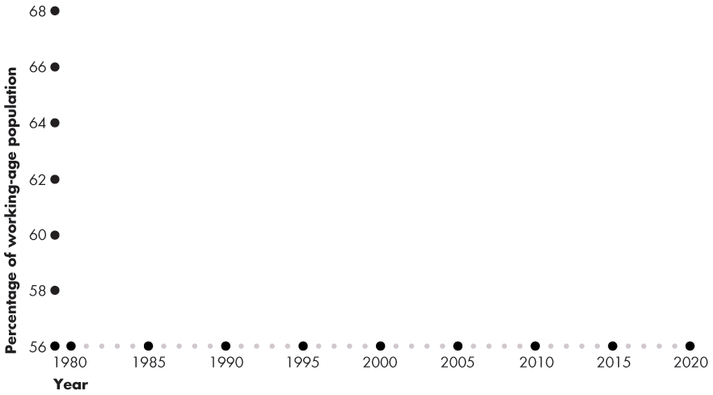
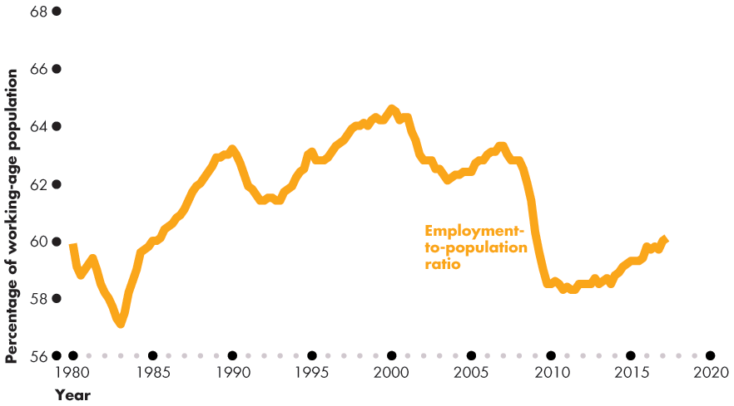
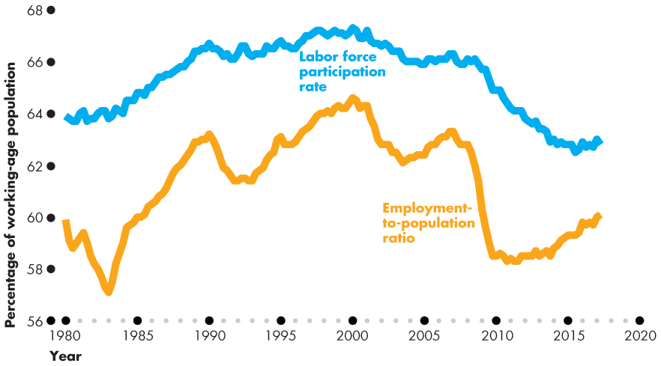
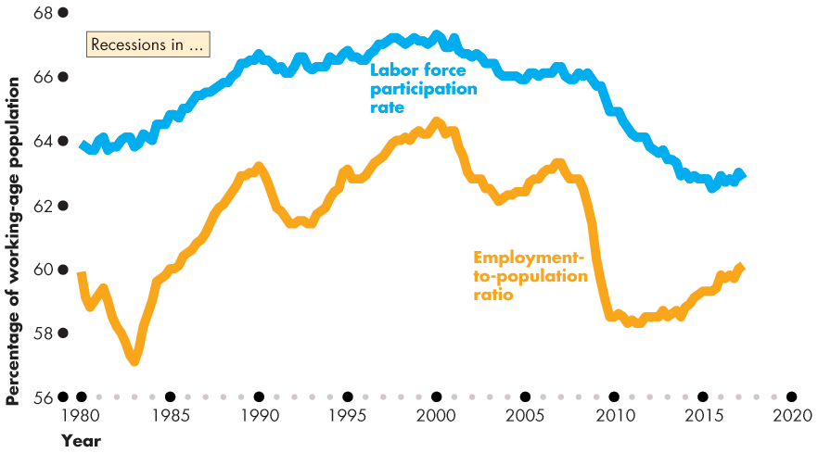
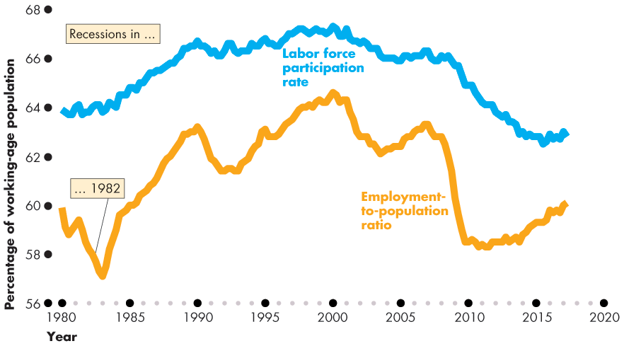
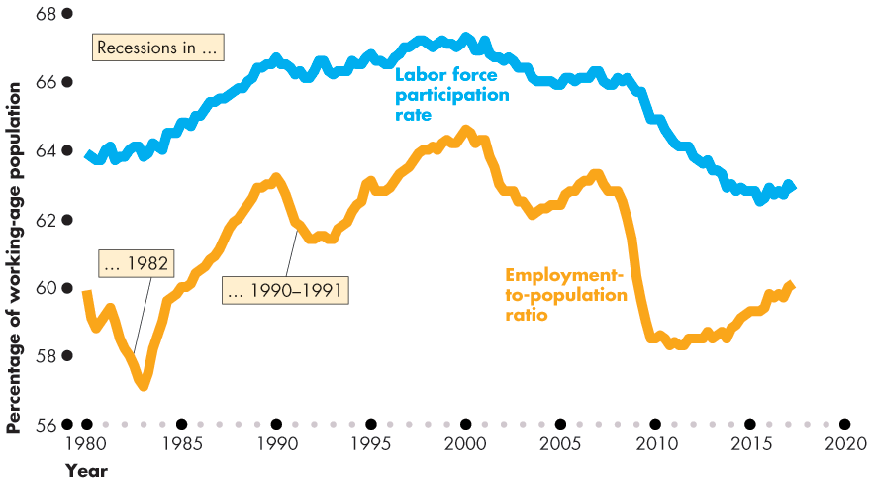

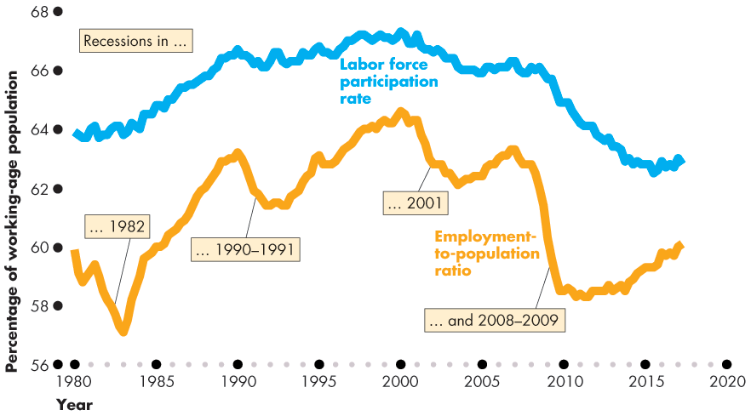
Employment and Unemployment
Figure 5.3 shows that the labor force participation rate and the employment-to-population ratio both trended upward before 2000 and downward after 2000.

Slide 19
Employment and Unemployment
Other Definitions of Unemployment
The purpose of the unemployment rate is to measure the underutilization of labor resources.
The BLS believes that the unemployment rate gives a correct measure.
But the official measure is an imperfect measure because it excludes
Marginally attached workers
Part-time workers who want full-time jobs

Slide 20
Employment and Unemployment
Marginally Attached Workers
A marginally attached worker is a person who currently is neither working nor looking for work but has indicated that he or she wants and is available for a job and has looked for work sometime in the recent past.
A discouraged worker is a marginally attached worker who has stopped looking for a job because of repeated failure to find one.

Slide 21
Employment and Unemployment
Part-Time Workers Who Want Full-Time Jobs
Many part-time workers want to work part time, but some part-time workers would like full-time jobs and can’t find them.
In the official statistics, these workers are called economic part-time workers and they are partly unemployed.
Most Costly Unemployment
All unemployment is costly, but the most costly is long-term unemployment that results from job loss.

Slide 22
Employment and Unemployment
Alternative Measures of Unemployment
The BLS reports six alternative measures of the unemployment rate: two narrower than the official measure and three broader ones.
The narrower measures, U-1 and U-2, focus on the personal cost of unemployment.
The broader measures, U-4, U-5, and U-6, focus on assessing the full amount of unused labor resources.
Notes:
Classroom activity
Check out Economics in the News: Jobs Growth at Full Employment

Slide 23
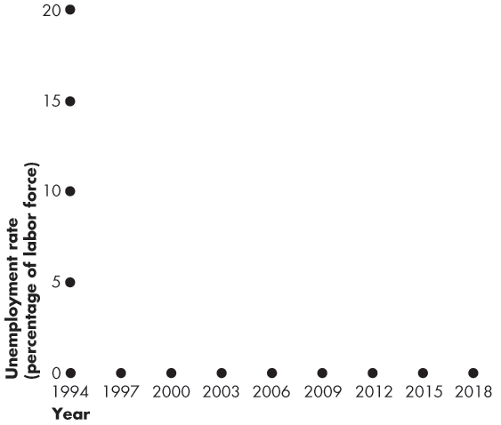
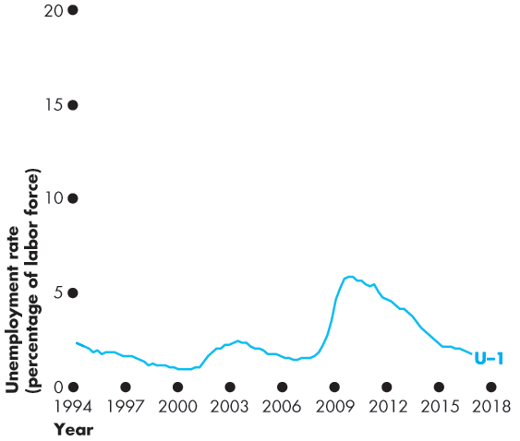
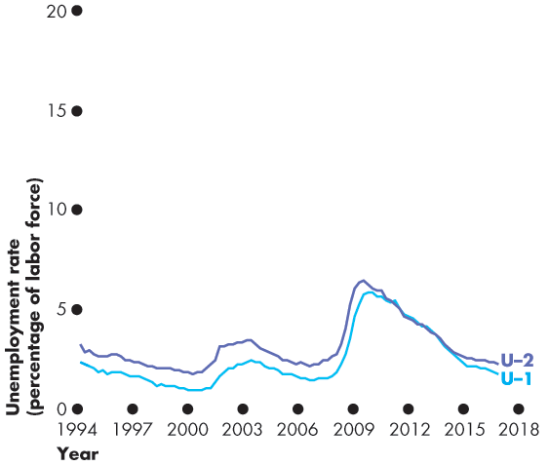
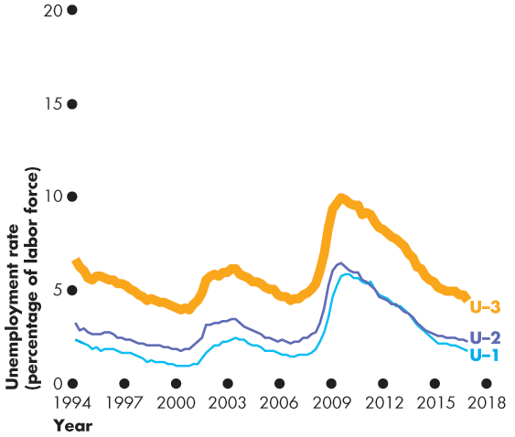
Employment and Unemployment
Figure 5.4 shows six alternative measures.
U-1: Those unemployed for 15 weeks or longer
U-2: Unemployed job losers
U-3: The official unemployment rate

Slide 24
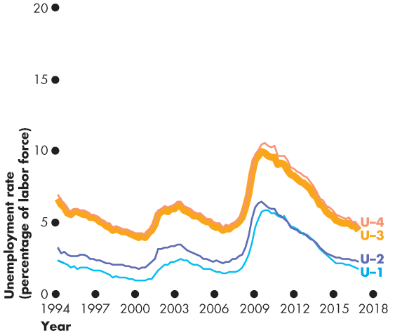
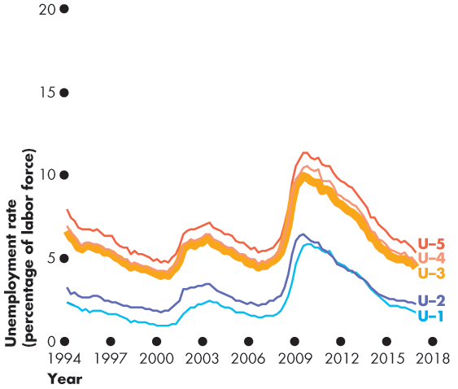
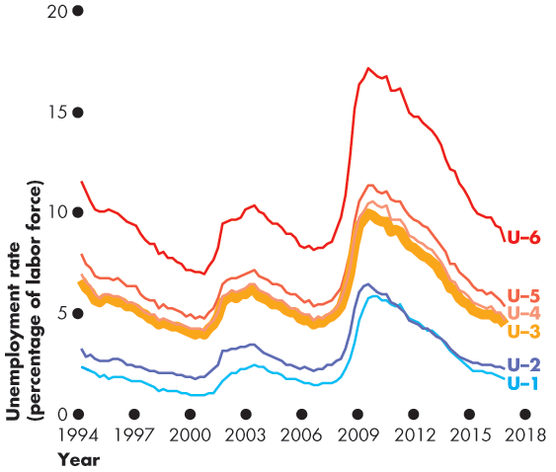
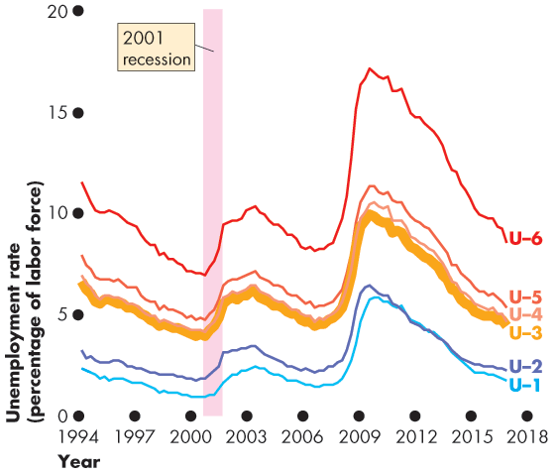
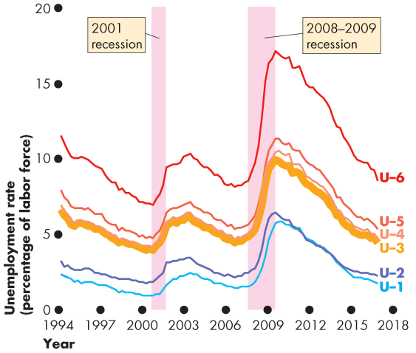

Slide 25
Employment and Unemployment
Broader measures are
U-4: U-3 + Discouraged workers
U-5: U-4 + Other marginally attached workers
U-6: U-4 + Part-time workers who want full-time jobs
All measures increase together in recession.

Slide 26
Unemployment and Full Employment
Unemployment can be classified into three types:
Frictional unemployment
Structural unemployment
Cyclical unemployment
Notes:
Identifying frictional, structural, and cyclical unemployment. Ask your class if anyone they know has been laid off. Then discuss whether losing a job creates frictional, structural, or cyclical unemployment. Look at your local examples. If you live in a steel-producing area, for example, you can talk about local structural unemployment arising from the closing of a steel manufacturer due to international competition. For cyclical unemployment, ask students how they think the business cycle and cyclical unemployment is related to full-time enrollments at higher education institutions. Students often don’t think there is any relationship. But nationally during a recession, the growth rate of full-time enrollments increases. Ask students if they can explain this relationship. The answer is that during a recession and due to the increase in cyclical unemployment, the opportunity cost of school decreases. This is a great way to keep students thinking about marginal benefits and costs.

Slide 27
Unemployment and Full Employment
Frictional Unemployment
Frictional unemployment is unemployment that arises from normal labor market turnover.
The creation and destruction of jobs requires that unemployed workers search for new jobs.
Increases in the number of people entering and reentering the labor force and increases in unemployment benefits raise frictional unemployment.
Frictional unemployment is a permanent and healthy phenomenon of a growing economy.

Slide 28
Unemployment and Full Employment
Structural Unemployment
Structural unemployment is unemployment created by changes in technology and foreign competition that change the skills needed to perform jobs or the locations of jobs.
Structural unemployment lasts longer than frictional unemployment.

Slide 29
Unemployment and Full Employment
Cyclical Unemployment
Cyclical unemployment is the higher than normal unemployment at a business cycle trough and lower than normal unemployment at a business cycle peak.
A worker who is laid off because the economy is in a recession and is then rehired when the expansion begins experiences cyclical unemployment.

Slide 30
Unemployment and Full Employment
“Natural” Unemployment
Natural unemployment is the unemployment that arises from frictions and structural change when there is no cyclical unemployment.
Natural unemployment is all frictional and structural unemployment.
The natural unemployment rate is natural unemployment as a percentage of the labor force.

Slide 31
Unemployment and Full Employment
Full employment is defined as the situation in which the unemployment rate equals the natural unemployment rate.
When the economy is at full employment, there is no cyclical unemployment or, equivalently, all unemployment is frictional and structural.

Slide 32
Unemployment and Full Employment
The natural unemployment rate changes over time and is influenced by many factors.
Key factors are
The age distribution of the population
The scale of structural change
The real wage rate
Unemployment benefits

Slide 33
Unemployment and Full Employment
Real GDP and Unemployment Over the Cycle
Potential GDP is the quantity of real GDP produced at full employment.
Potential GDP corresponds to the capacity of the economy to produce output on a sustained basis.
Real GDP minus potential GDP is the output gap.
Over the business cycle, the output gap fluctuates and the unemployment rate fluctuates around the natural unemployment rate.
Notes:
Classroom activity
Check out Economics in Action: Another Look at Full Employment

Slide 34
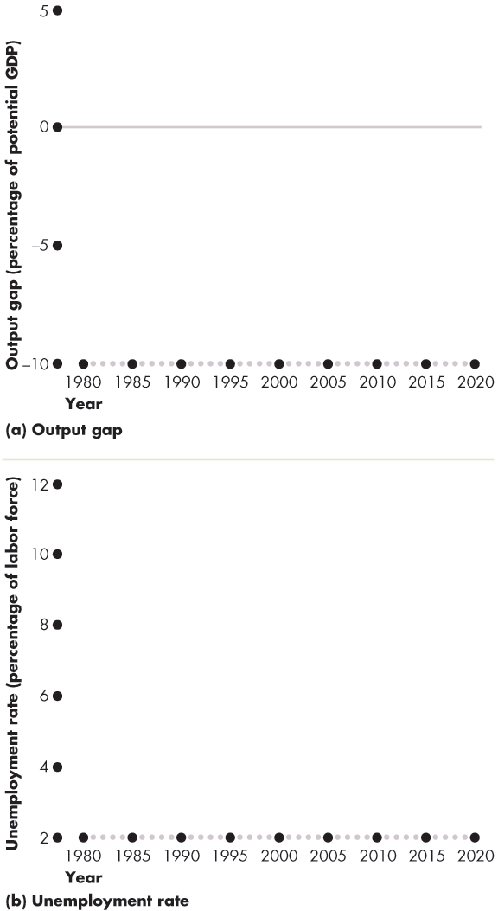
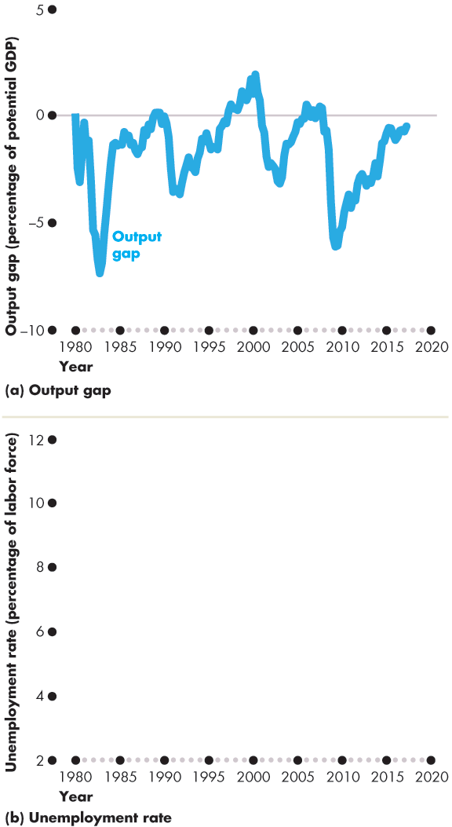
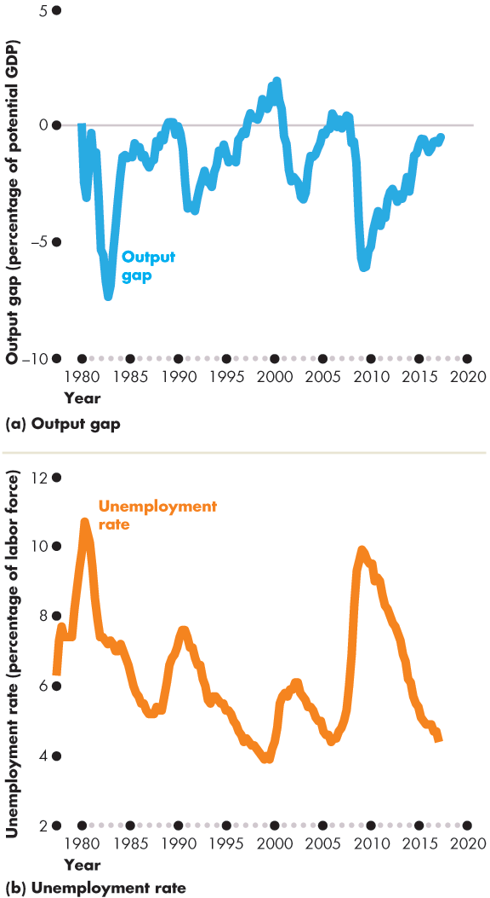
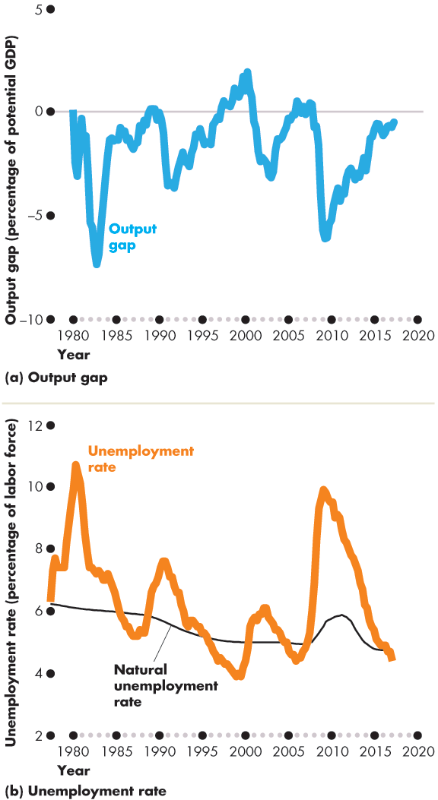
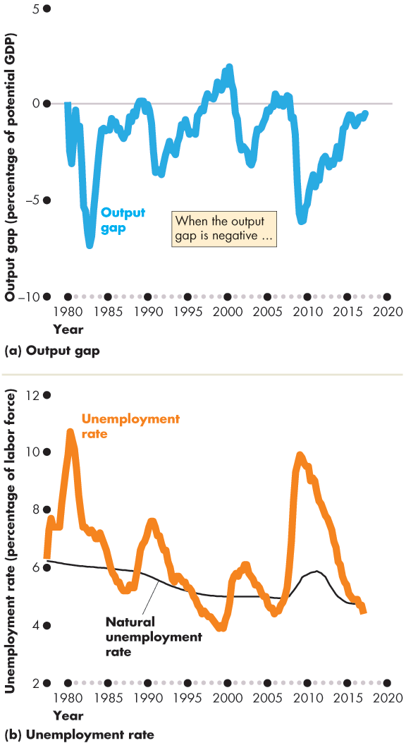
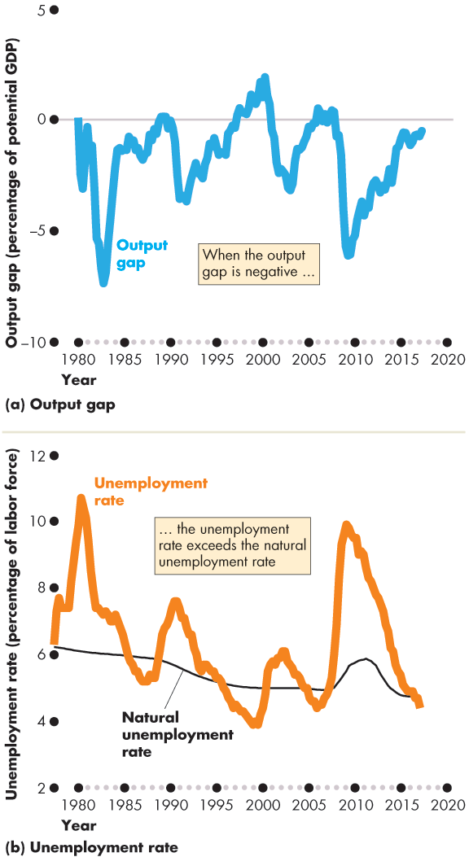
Unemployment and Full Employment
Figure 5.5 shows the output gap and …
the fluctuations of unemployment around the natural rate.
When the output gap is negative, ...
the unemployment rate exceeds the natural unemployment rate.

Slide 36
Price Level, Inflation, and Deflation
The price level is the average level of prices and the value of money.
A persistently rising price level is called inflation.
A persistently falling price level is called deflation.
We are interested in the price level because we want to
1. Measure the inflation rate or the deflation rate
2. Distinguish between money values and real values of economic variables.

Slide 37
Price Level, Inflation, and Deflation
Why Inflation and Deflation Are Problems
Low, steady, and anticipated inflation or deflation is not a problem.
Unpredictable inflation or deflation is a problem because it
Redistributes income
Redistributes wealth
Lowers real GDP and employment
Diverts resources from production

Slide 38
Price Level, Inflation, and Deflation
Unpredictable changes in the inflation rate redistribute income in arbitrary ways between employers and workers and between borrowers and lenders.
A high inflation rate is a problem because it diverts resources from productive activities to inflation forecasting.
From a social perspective, this waste of resources is a cost of inflation.
At its worst, inflation becomes hyperinflation—an inflation rate that is so rapid that workers are paid twice a day because money loses its value so quickly.

Slide 39
Price Level, Inflation, and Deflation
The Consumer Price Index
The Consumer Price Index, or CPI, measures the average of the prices paid by urban consumers for a “fixed” basket of consumer goods and services.
Notes:
The CPI—an average. It is important for students to understand that the CPI is based on the average expenditure basket, not the expenditure pattern of any given household. Displaying the detailed press releases on the BLS Web site helps make this point very forcibly: students often do not realize until they see the numbers that the CPI must include both costs of owning a house and costs of renting one; costs of buying a car and costs of public transportation; and so on.

Slide 40
Price Level, Inflation, and Deflation
Reading the CPI Numbers
The CPI is defined to equal 100 for the reference base period.
Currently, the reference base period is 1982−1984.
That is, for the average of the 36 months from January 1982 through December 1984, the CPI equals 100.
In June 2017, the CPI was 245.
This number tells us that the average of the prices paid by urban consumers for a fixed basket of goods was 145 percent higher in June 2017 than it was during 1982−1984.

Slide 41
Price Level, Inflation, and Deflation
Constructing the CPI
Constructing the CPI involves three stages:
Selecting the CPI basket
Conducting a monthly price survey
Calculating the CPI

Slide 42
Price Level, Inflation, and Deflation
The CPI Basket
The CPI basket is based on a Consumer Expenditure Survey, which is undertaken infrequently.
The CPI basket today is based on data collected in the Consumer Expenditure Survey of 2016.

Slide 43
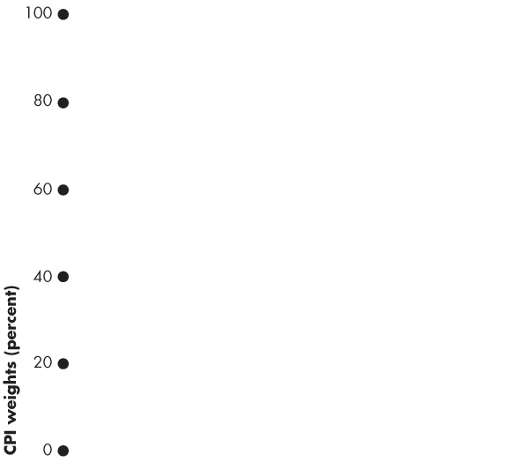
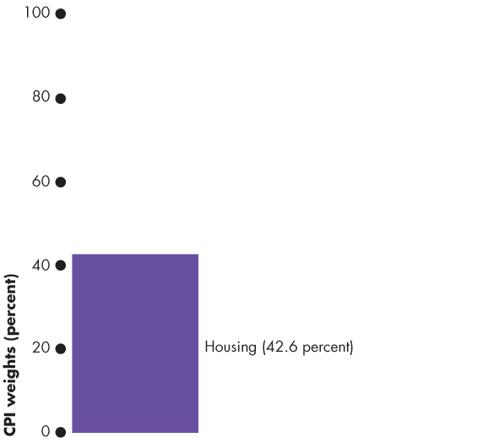
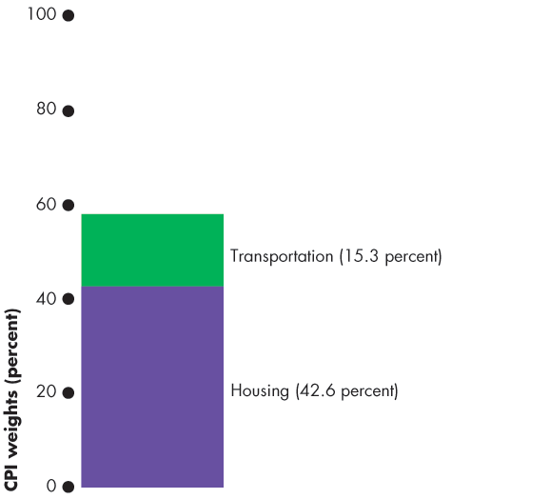
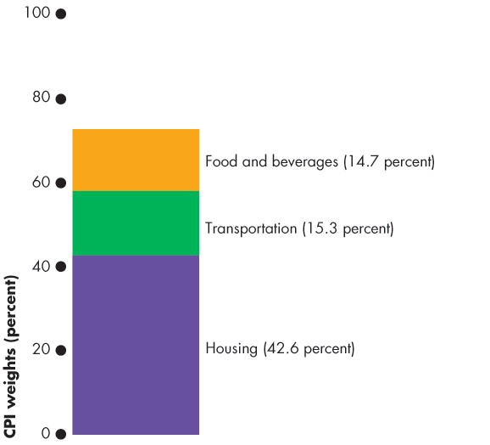
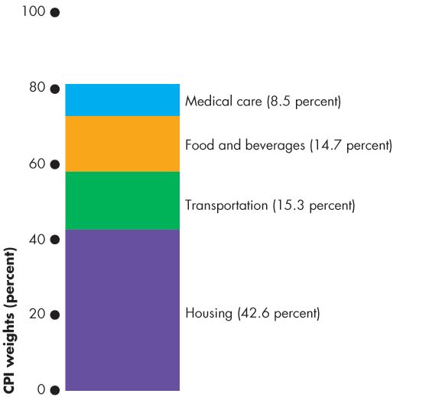
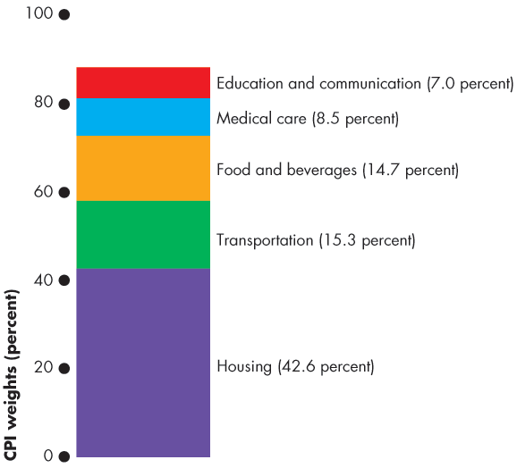
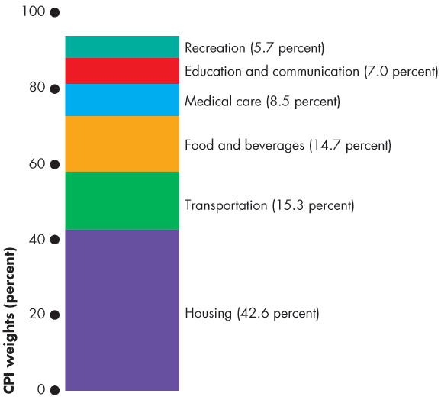
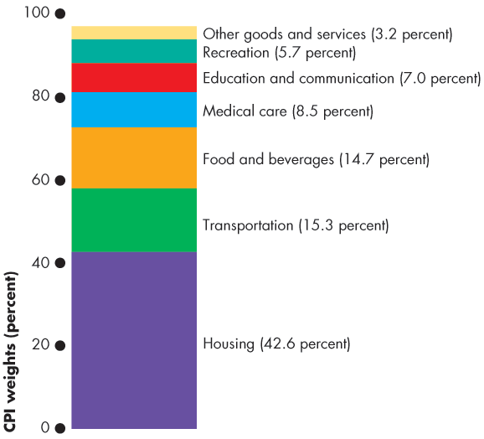
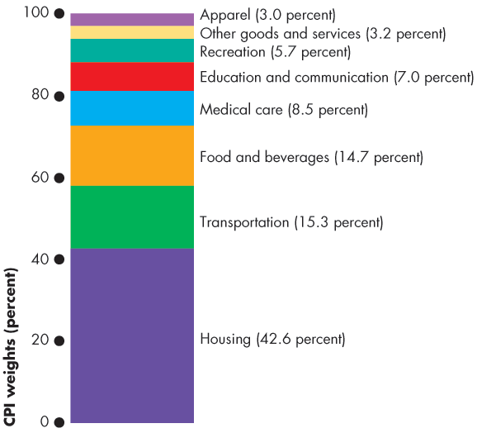
Price Level, Inflation, and Deflation
Figure 5.6 illustrates the CPI basket.
Housing is the largest component.
Transportation and food and beverages are the next largest components.
All other components account for 27.4 percent of the basket.
Notes:
Making the CPI personal. If you have time (or want to make time) you can get your students to construct their own CPI basket. Each student makes a statement of her/his expenditure in the same categories as the CPI basket in the figure on this slide. Students then compare their expenditure patterns to the average of the CPI basket.

Slide 45
Price Level, Inflation, and Deflation
The Monthly Price Survey
Every month, BLS employees check the prices of the 80,000 goods in the CPI basket in 30 metropolitan areas.
Calculating the CPI
1. Find the cost of the CPI basket at base-period prices.
2. Find the cost of the CPI basket at current-period prices.
3. Calculate the CPI for the current period.

Slide 46
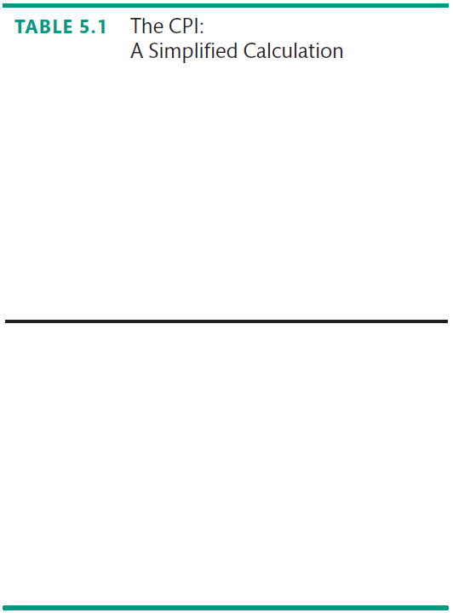
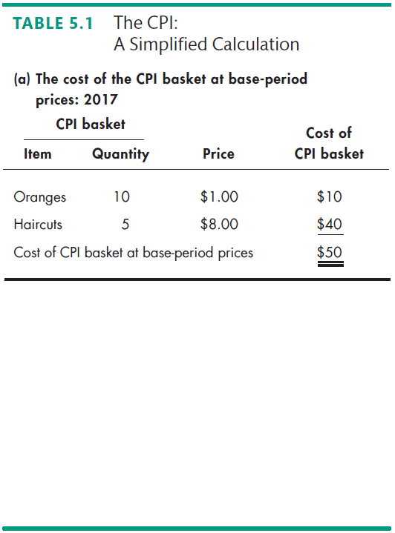
Price Level, Inflation, and Deflation
Let’s work an example of the CPI calculation.
In a simple economy, people consume only oranges and haircuts.
The CPI basket is 10 oranges and 5 haircuts.
The table also shows the prices in the base period.
The cost of the CPI basket in the base period was $50.

Slide 47
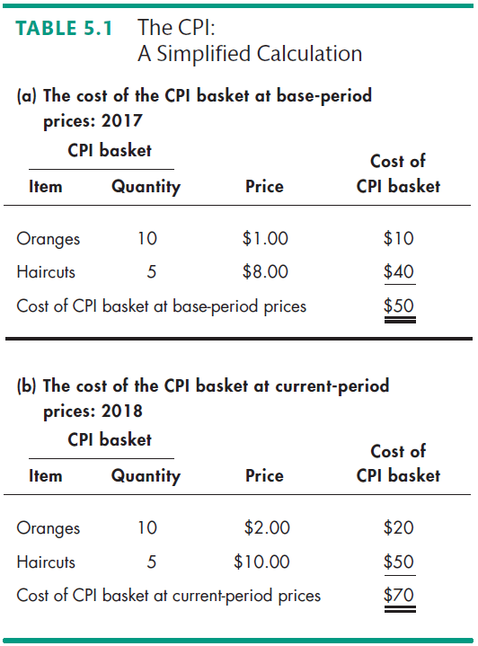

Slide 48
Price Level, Inflation, and Deflation
Table 5.1(b) shows the fixed CPI basket of goods.
It also shows the prices in the current period.
The cost of the CPI basket at current-period prices is $70.

Slide 49
Price Level, Inflation, and Deflation
The CPI is calculated using the formula:
CPI = (Cost of basket at current-period prices ÷ Cost of basket at base-period prices) x 100.
Using the numbers for the simple example,
CPI = ($70 ÷ $50) x 100 = 140.
The CPI is 40 percent higher in the current period than it was in the base period.

Slide 50
Price Level, Inflation, and Deflation
Measuring the Inflation Rate
The major purpose of the CPI is to measure inflation.
The inflation rate is the percentage change in the price level from one year to the next.
The inflation formula is:
Inflation rate = [(CPI this year – CPI last year) ÷ CPI last year] × 100.

Slide 51






Price Level, Inflation, and Deflation
Figure 5.7 shows the relationship between the price level and the inflation rate.
The inflation rate is
High when the price level is rising rapidly.
Low when the price level is rising slowly.
Negative when the price level is falling.

Slide 53
Price Level, Inflation, and Deflation
The Biased CPI
The CPI might overstate the true inflation rate for four reasons:
New goods bias
Quality change bias
Commodity substitution bias
Outlet substitution bias
Notes:
CPI biases—concrete illustrations. New goods bias can be illustrated with MP3 music rather than CDs; quality change with computers and cars; commodity substitution with movies versus videos; and outlet substitution by the growth of Wal-mart, Target, and shopping on the internet.

Slide 54
Price Level, Inflation, and Deflation
New Goods Bias
New goods that were not available in the base year appear and, if they are more expensive than the goods they replace, they put an upward bias into the CPI.
Quality Change Bias
Quality improvements occur every year. Part of the rise in the price is payment for improved quality and is not inflation.
The CPI counts all the price rise as inflation.

Slide 55
Price Level, Inflation, and Deflation
Commodity Substitution Bias
The market basket of goods used in calculating the CPI is fixed and does not take into account consumers’ substitutions away from goods whose relative prices increase.
Outlet Substitution Bias
As the structure of retailing changes, people switch to buying from cheaper sources, but the CPI, as measured, does not take account of this outlet substitution.

Slide 56
Price Level, Inflation, and Deflation
The Magnitude of the Bias
An estimate made in 1996 says that the CPI overstates inflation by 1.1 percentage points a year.
Some Consequences of the Bias
Distorts private contracts.
Increases government outlays (close to a third of federal government outlays are linked to the CPI).
The BLS has now corrected much of the bias, but some still remains.

Slide 57
Price Level, Inflation, and Deflation
Alternative Price Indexes
Alternative measures of the price level are
Chained CPI
Personal consumption expenditure deflator
GDP deflator

Slide 58
Price Level, Inflation, and Deflation
Chained CPI
The chained CPI is a price index that is calculated using a similar method to that used to calculate chained-dollar real GDP described in Chapter 21.

Slide 59
Price Level, Inflation, and Deflation
Personal Consumption Expenditure Deflator
The PCE deflator equals
(Nominal consumption expenditure ÷ Real consumption expenditure) x 100
PCE deflator is a broader measure of the price level than the CPI because it includes all consumption expenditure.
GDP Deflator
GDP deflator is like the PCE deflator except it includes the prices of all goods and services that are counted in GDP.

Slide 60
Price Level, Inflation, and Deflation
Core and Sticky-Price Inflation
The core inflation rate attempts to reveal the underlying inflation trend.
The core inflation rate is calculated as the percentage change in the PCE index excluding the prices of food and fuel, the two most volatile prices.
If the relative prices of the excluded items are changing, the core inflation rate will be a biased measure of the inflation.
A new method of revealing the inflation trend is to calculate the sticky-price inflation rate, which is the rate at which infrequently adjusted prices are changing.

Slide 61




Price Level, Inflation, and Deflation
Figure 5.8 graphs the measured inflation rates.
The core inflation rate is below the CPI inflation.
The sticky-price inflation rate fluctuated less than the CPI inflation rate, but they have a similar average.

